Slide 1

Tourism Web Application
Group 09
CMIS 3122
202130 – S.R.V Perera
202155- H.M.P Senarathna
Department of Computing and Information System
Faculty of Applied Sciences
Wayamba University of Sri Lanka
Kuliyapitiya

Slide 2
CONTENT
Introduction
Objective
ER diagram
Project Functionalities
Tools and Technology used
Future Enhancement
Demonstration

Slide 3
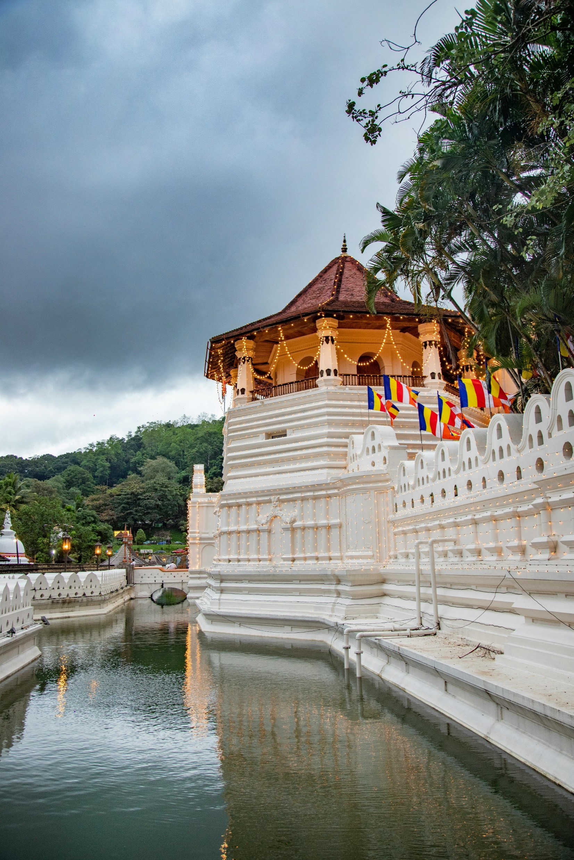
INTRODUCTION
This is a platform for tourists who like to visit Sri Lanka.
The system has been specially designed for booking a tour in Sri Lanka.

